Slide 1
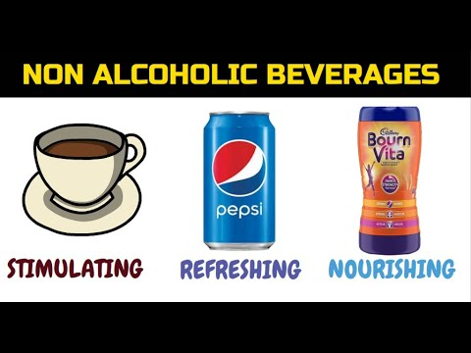
CLASSIFICATION OF NON ALCOHOLIC BEVERAGES
Presented by Urmi Das
Faculty
B.Voc (CTHM)

Slide 2
NON- ALCOHOLIC BEVERAGES
It covers drinks that are totally free from alcohol .Some of these drinks are made in the still room while some are made in dispense bar. Every sector of the food service industry serves one or more type of non alcoholic drinks.

Slide 3
categories of non alcoholic beverages
They are dispensed from bar
1.Areated water
2. Natural water
3. Squashes
4.Juices
5. Syrups

Slide 4
categories of non alcoholic beverages
They are made in still room
Coffee
Tea
Milk-based drinks-cholcolate
malted drinks

Slide 5
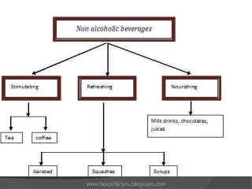
categories of non alcoholic beverages

Slide 6


